Slide 1
Sdsoc project

Slide 2
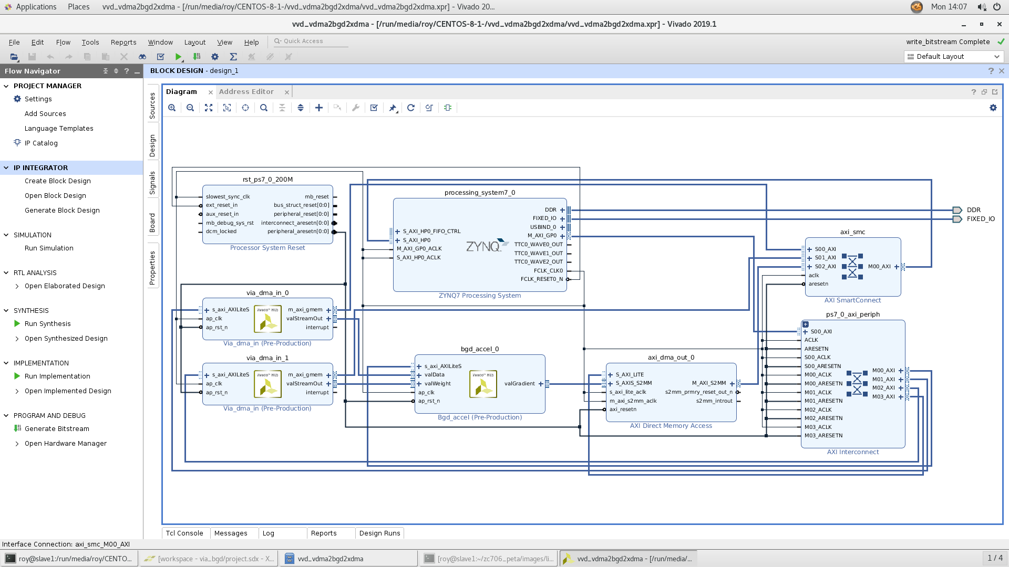
Minst accel

Slide 3
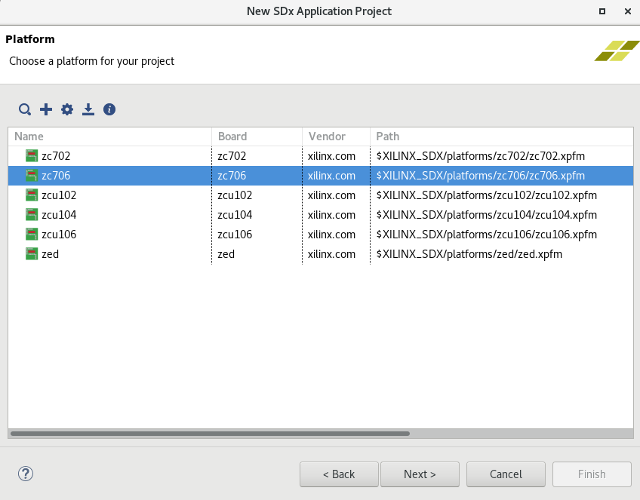
Implement in sdsoc
Create application project

Slide 4
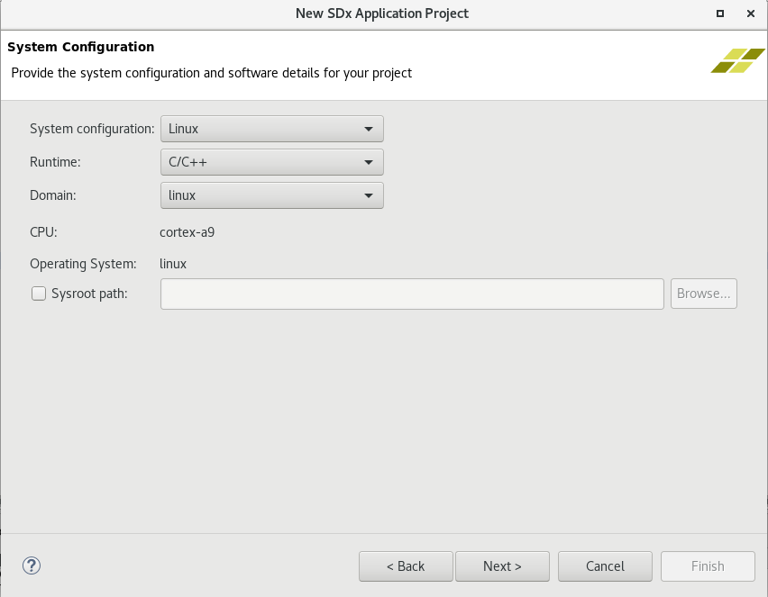
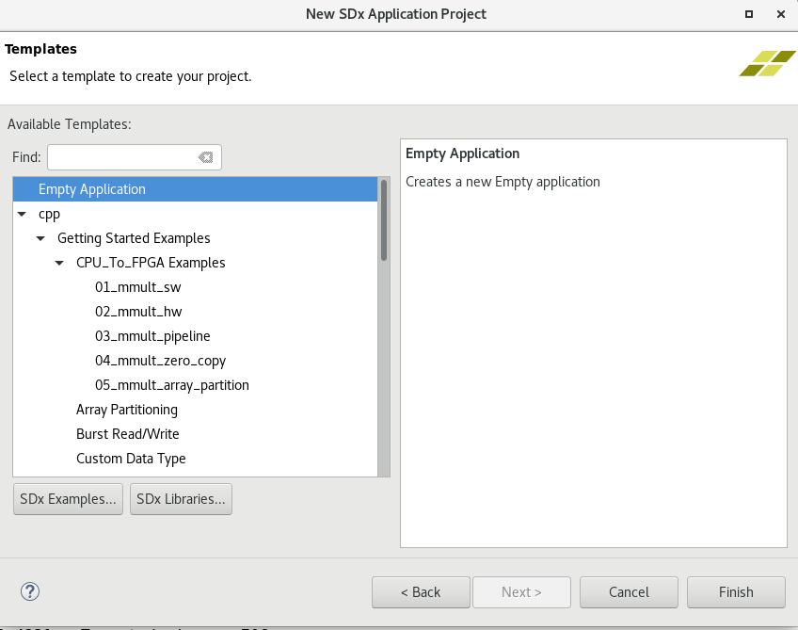

Slide 5
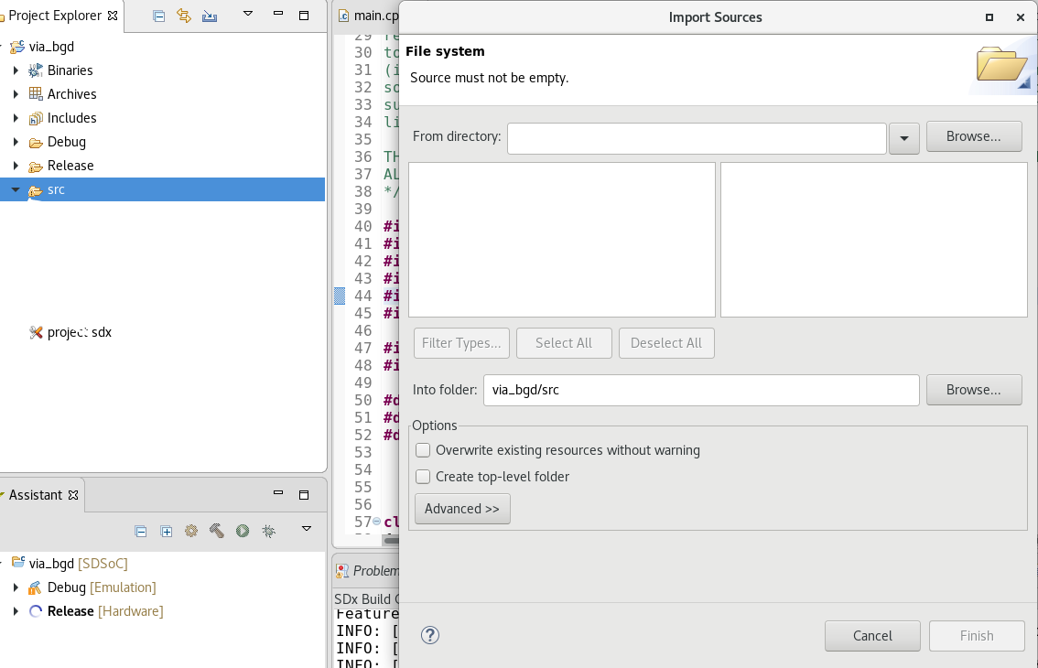

Slide 6
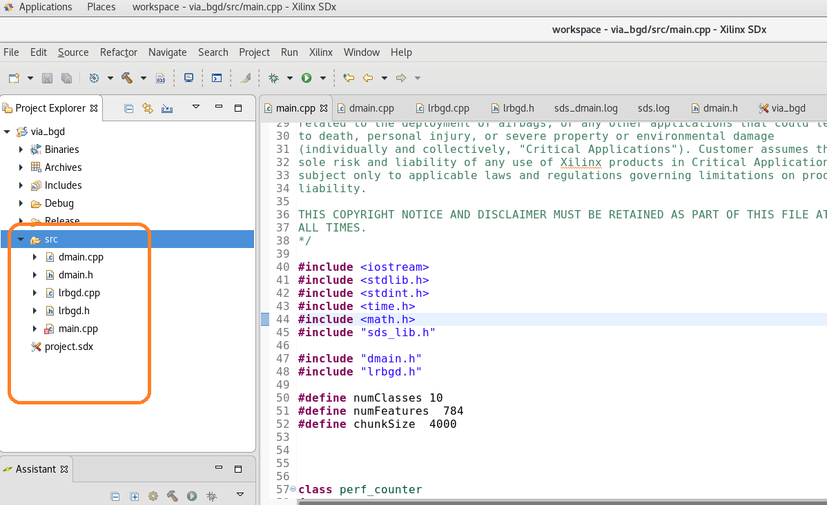

Slide 7
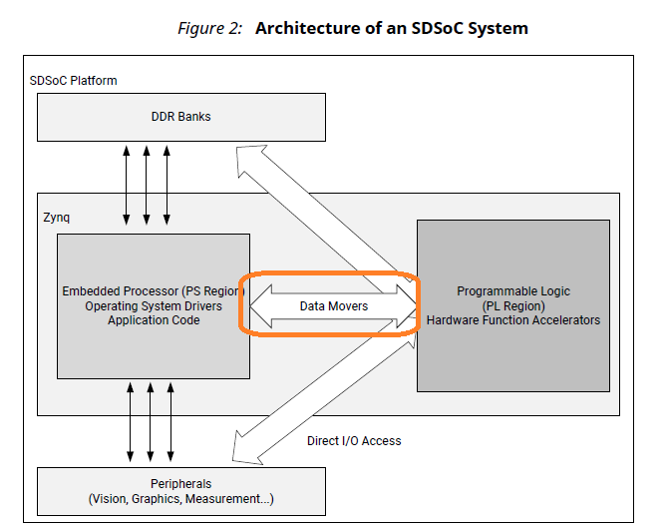
Ｄａｔａ ｍｏｖｅｒｓ
Two pragma:
[A]
#pragma SDS data zero_copy(buf[0:len])
#pragma SDS data sys_port (A:HP)
Data movers: data moves between PS ＆ＰＬ
[B]
#pragma SDS datacopy(buf[0:len])
#pragma SDS data sys_port (B:GP)
data sys_port: ACP, HP, GP

Slide 8
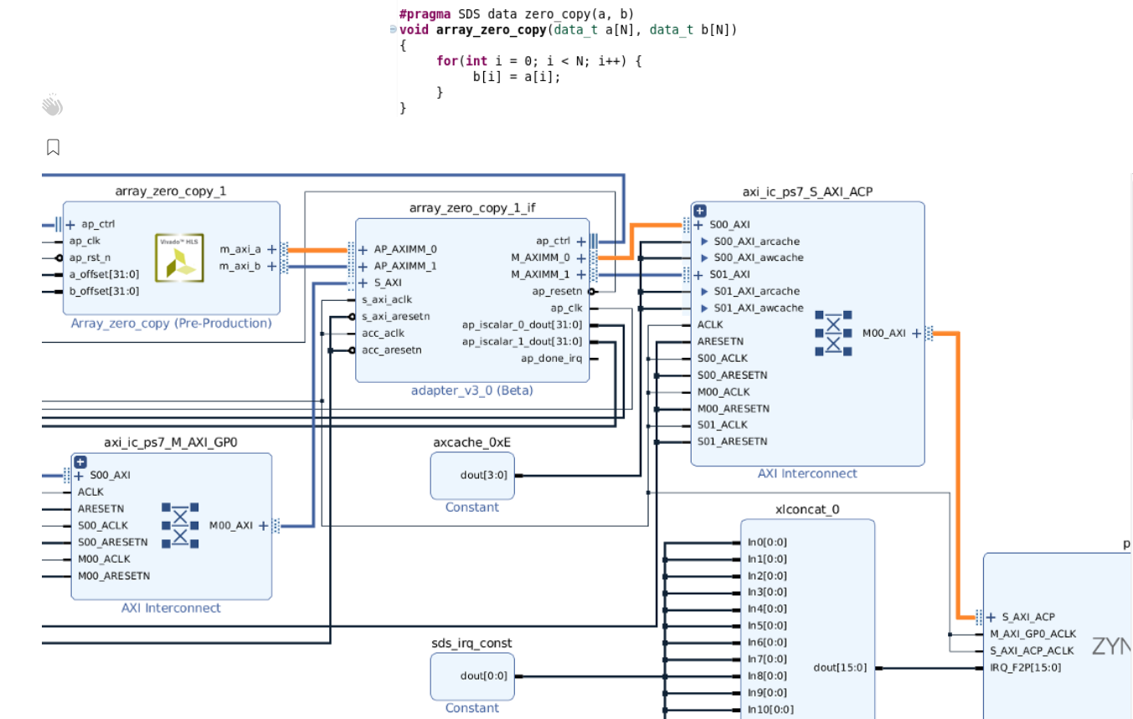
Data zero_copy

Slide 9
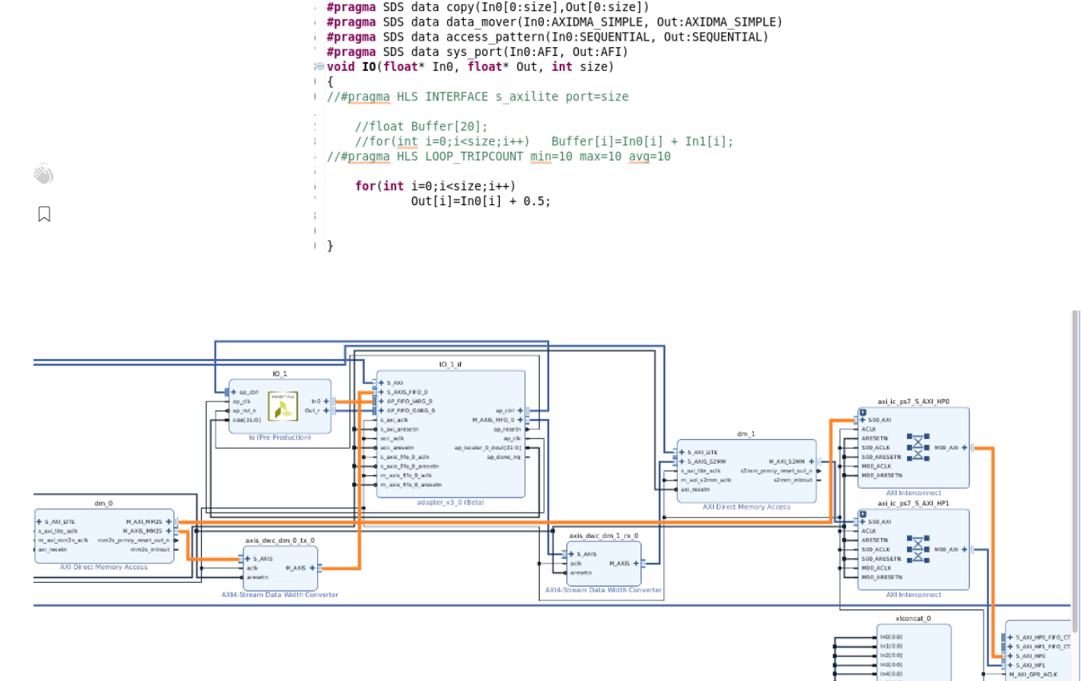
Data copy

Slide 10
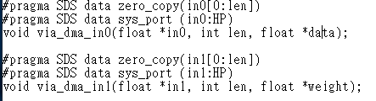
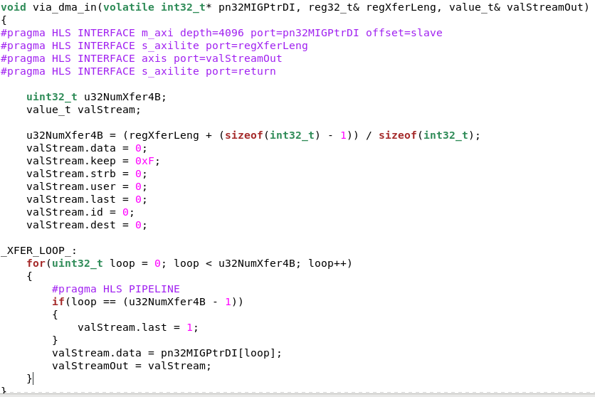
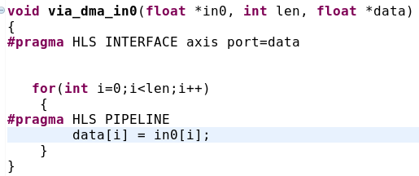
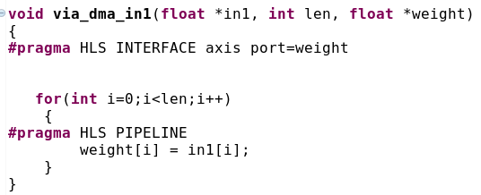
Modify hls

Slide 11
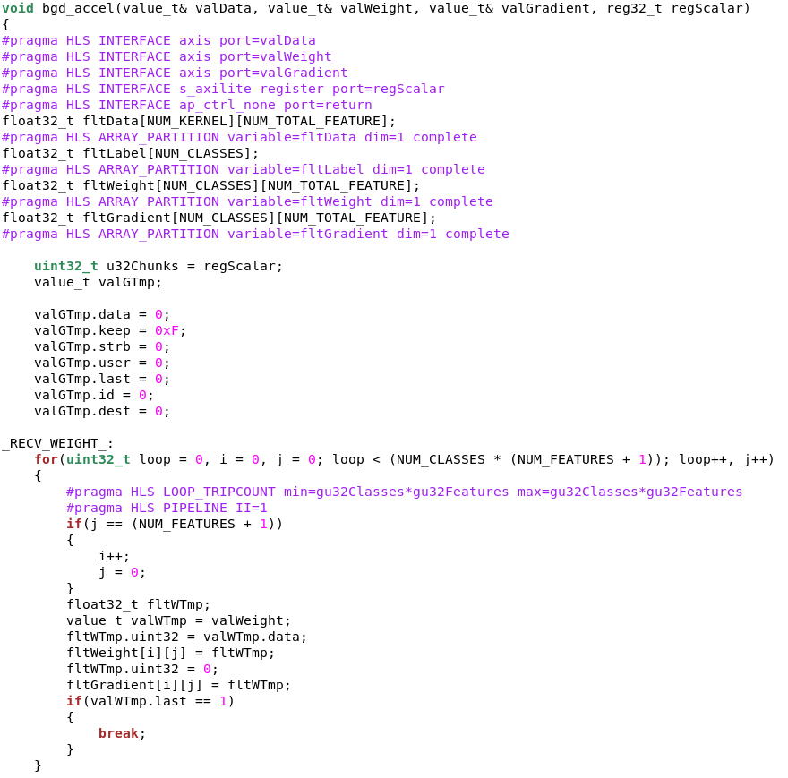
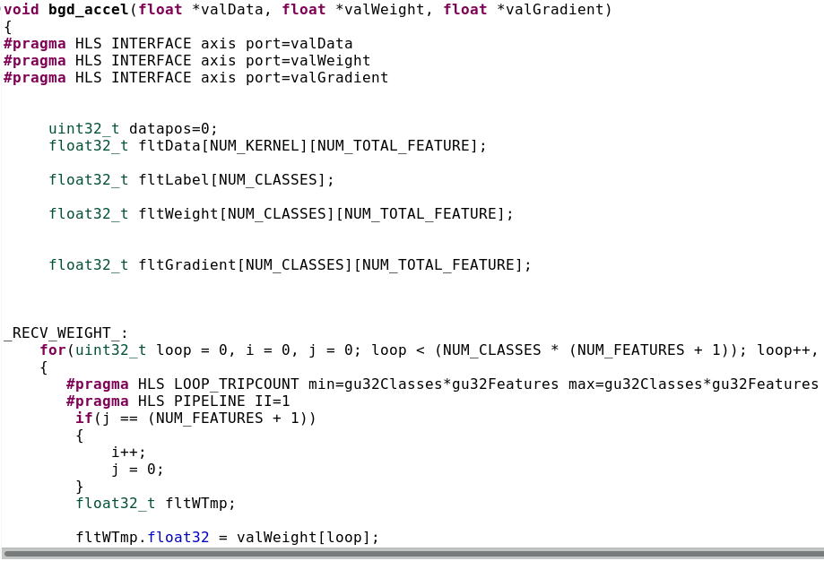

Slide 12

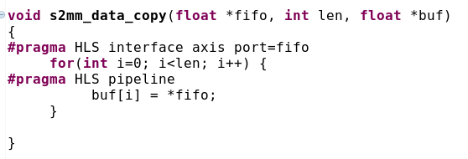
s2mm

Slide 13


main
SW golden
HW implement

Slide 14
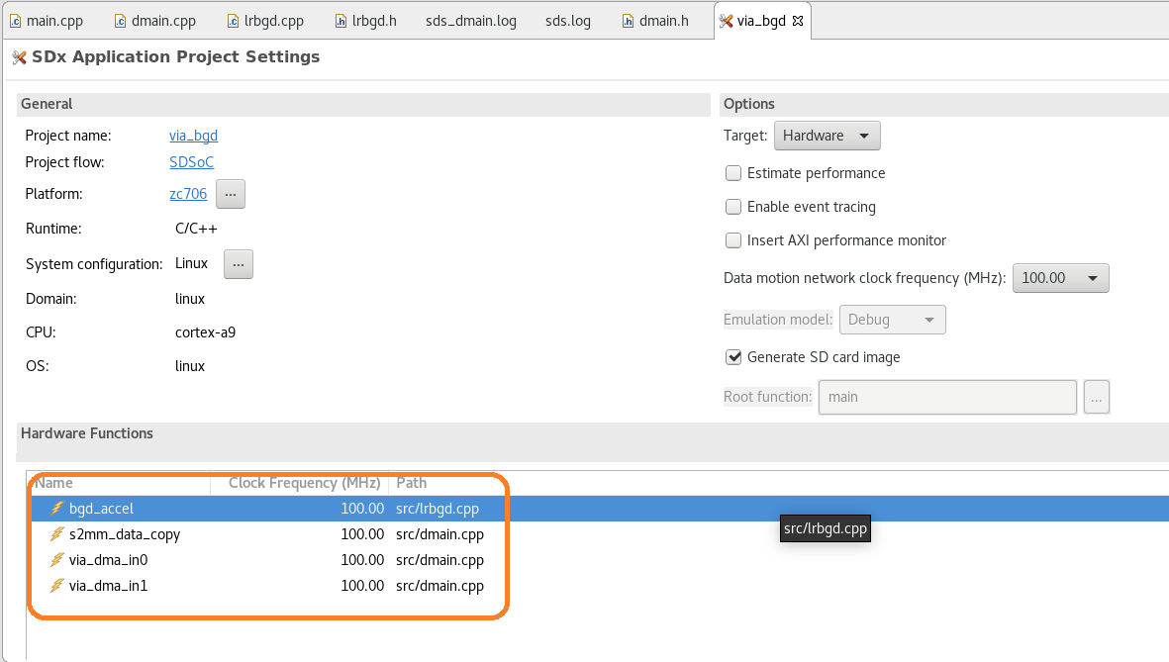
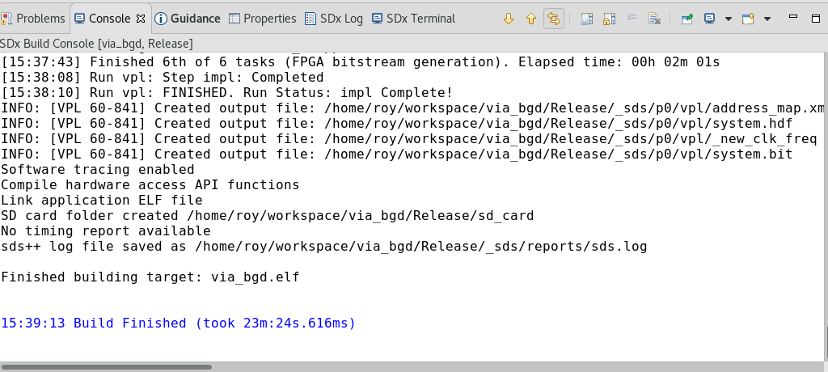

Slide 15
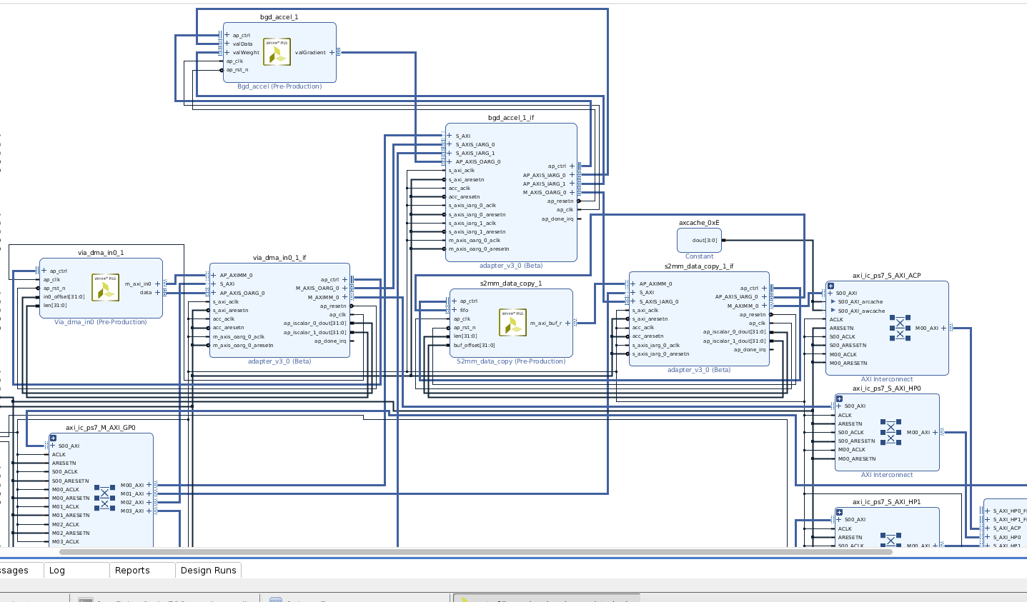
vivado

Slide 16
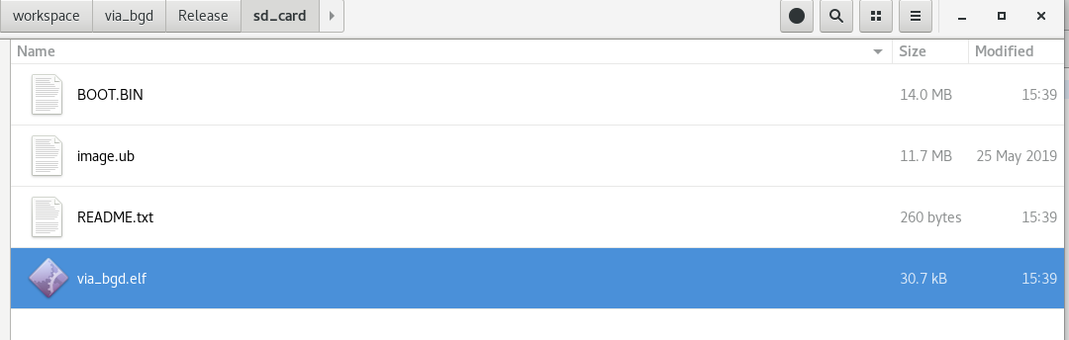

Slide 17
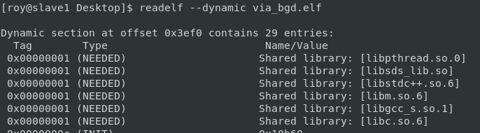

Slide 18
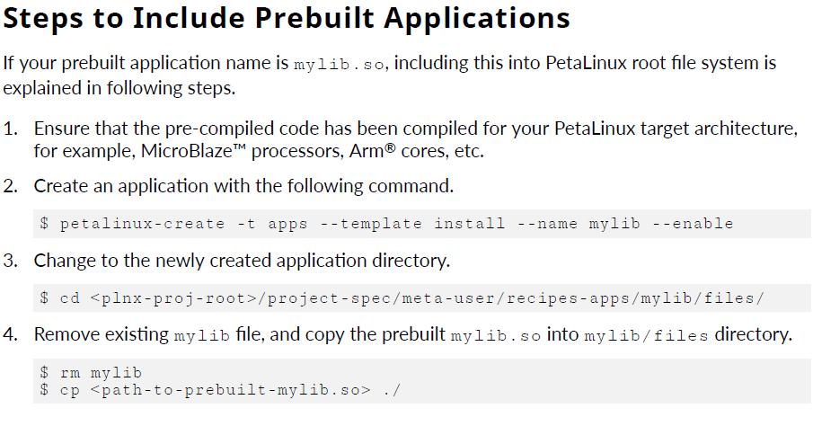
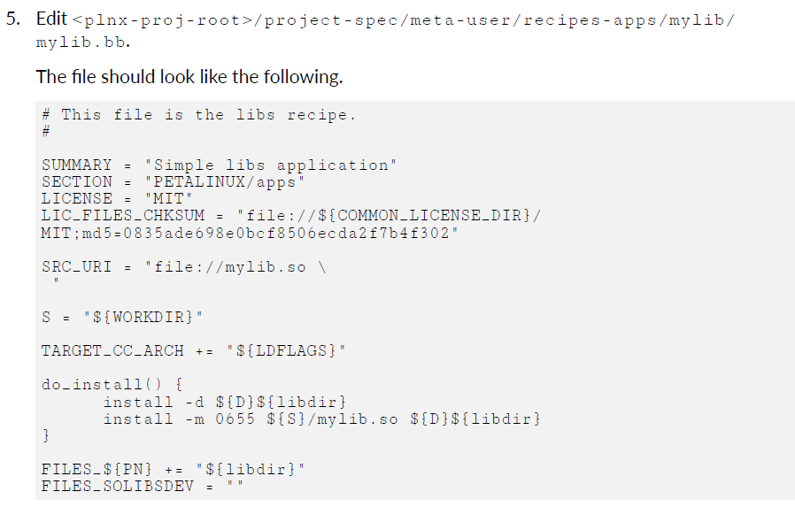
Build libsds_lib.so into /usr/lib

Slide 19
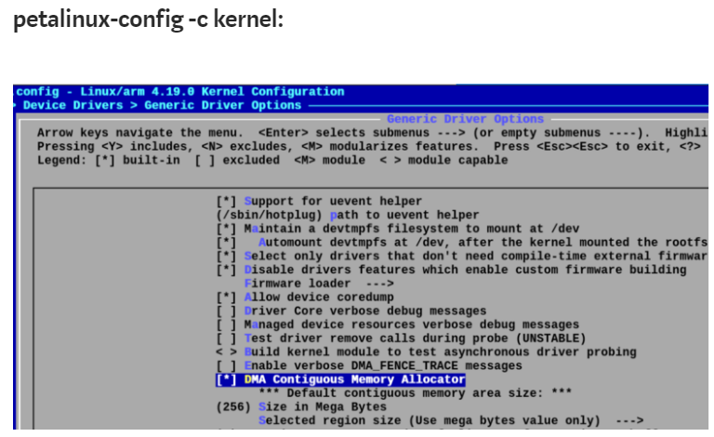
custom platform

Slide 20
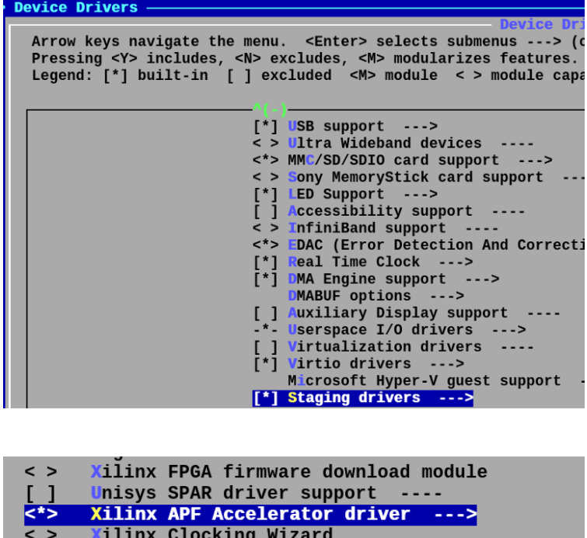

Slide 21
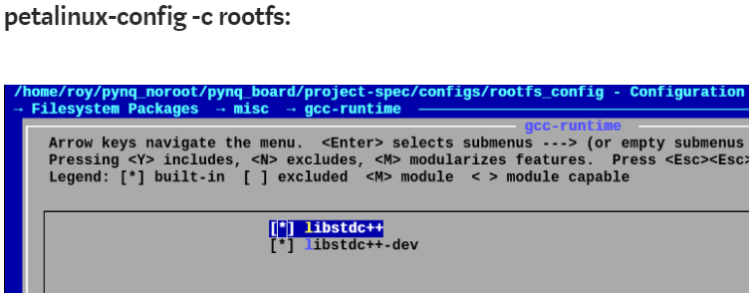
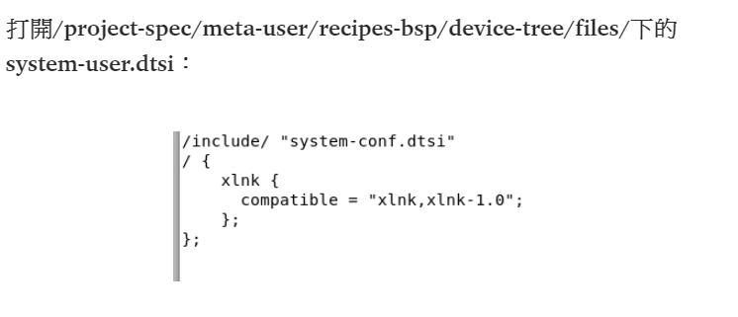

Slide 22
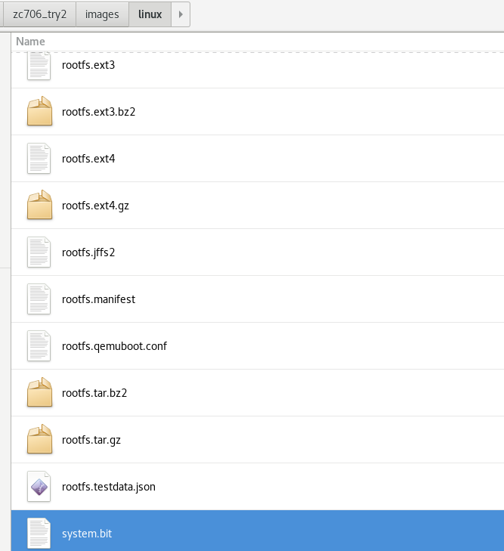
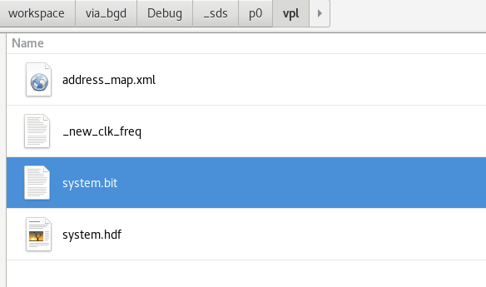
Replace system.bit

Slide 23
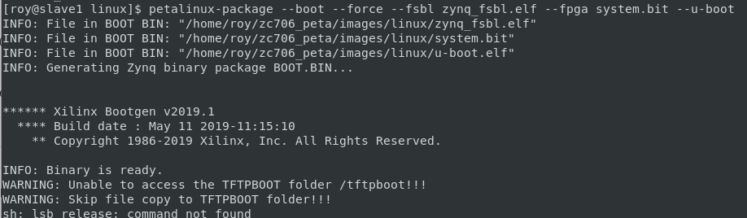
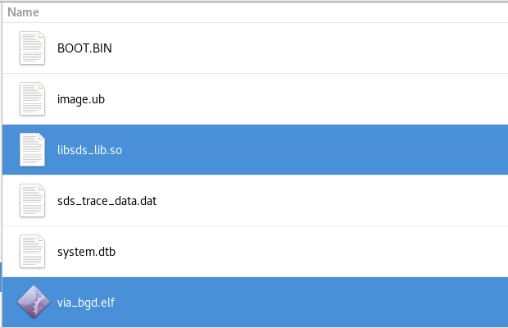

Slide 24
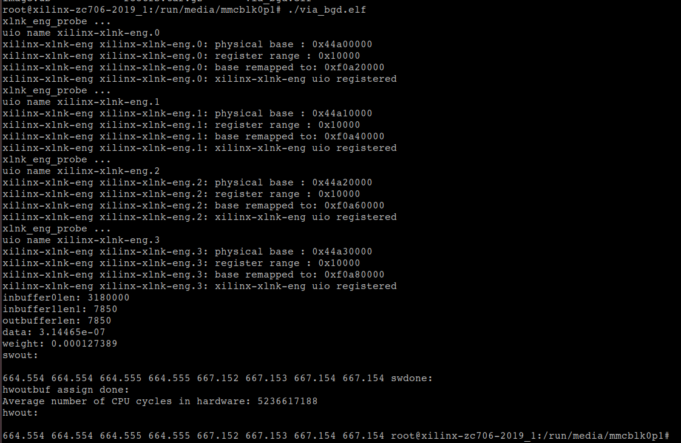

Slide 25
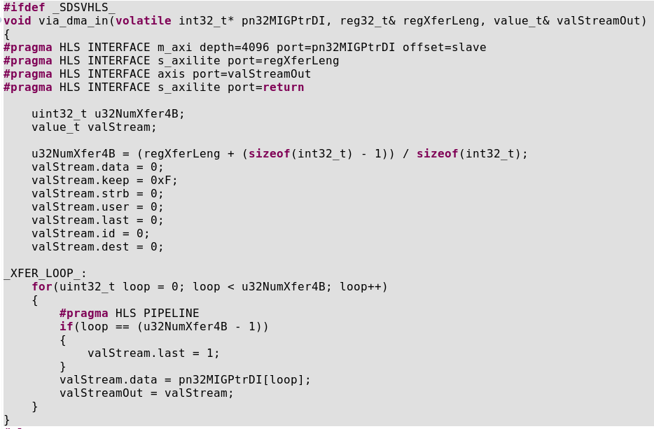
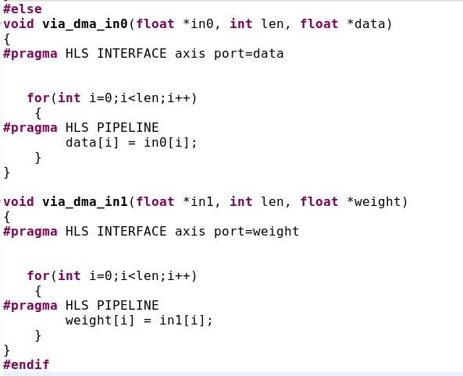

Slide 26
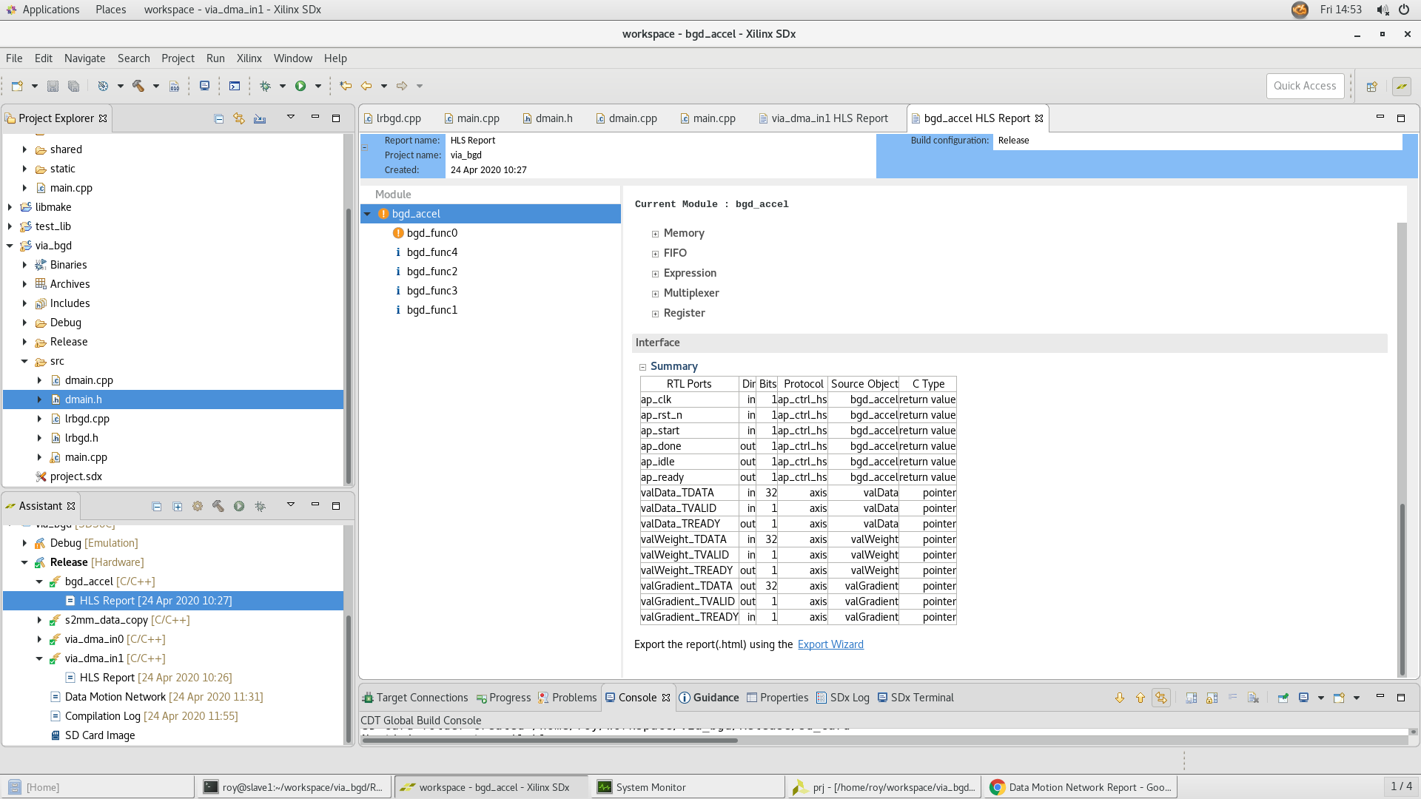

Slide 27
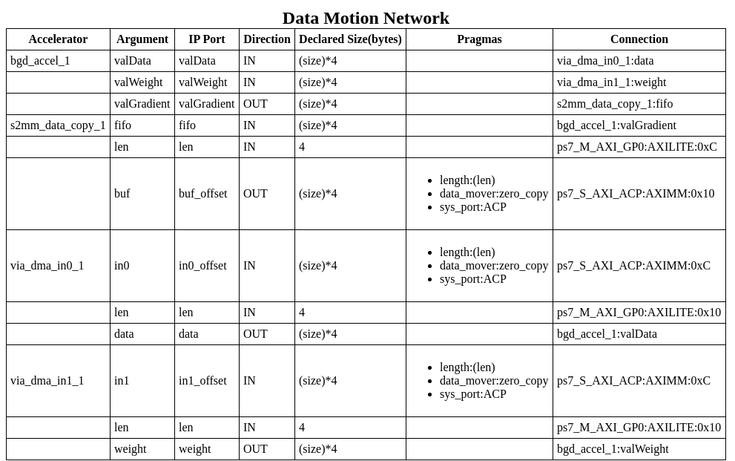

Slide 28
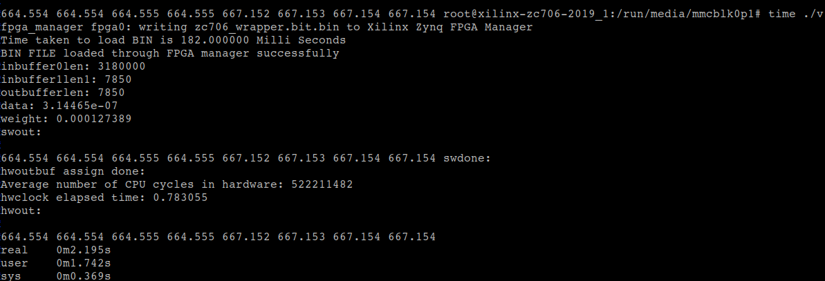

Slide 29
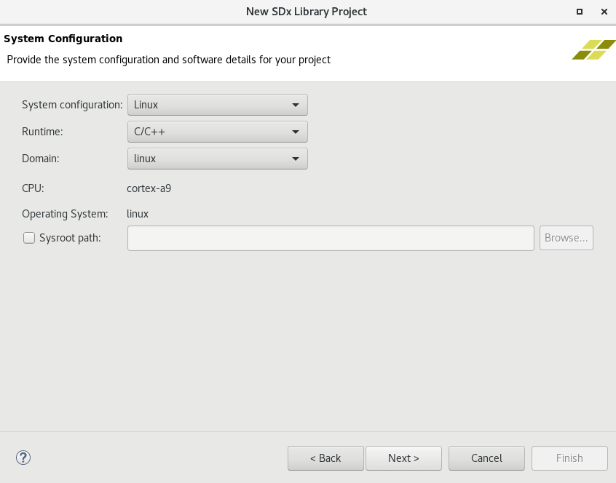
Create library

Slide 30
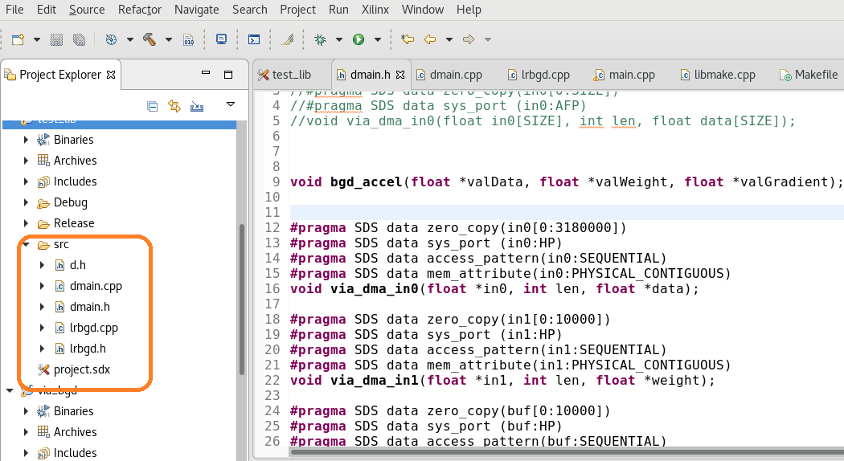

Slide 31
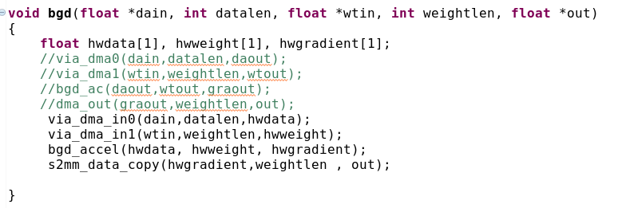
Wrap function

Slide 32
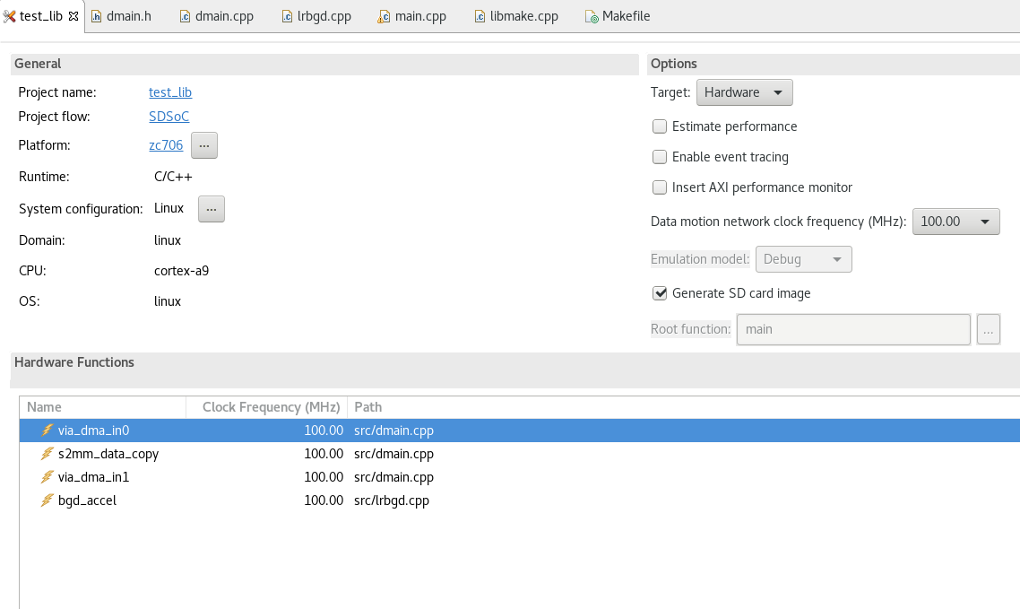
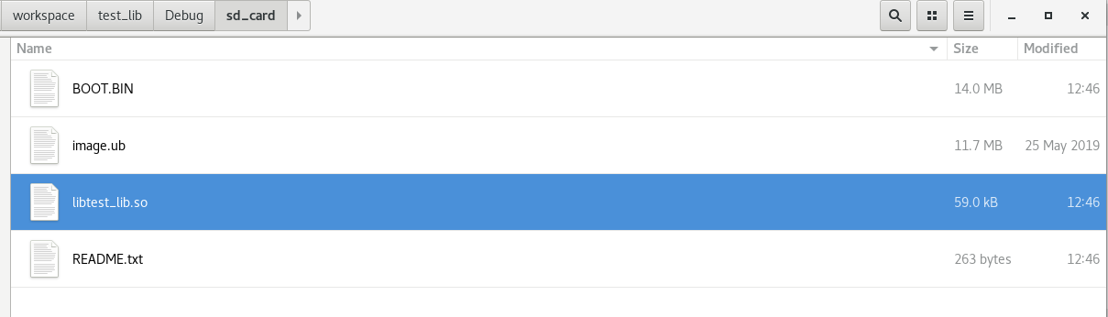

Slide 33
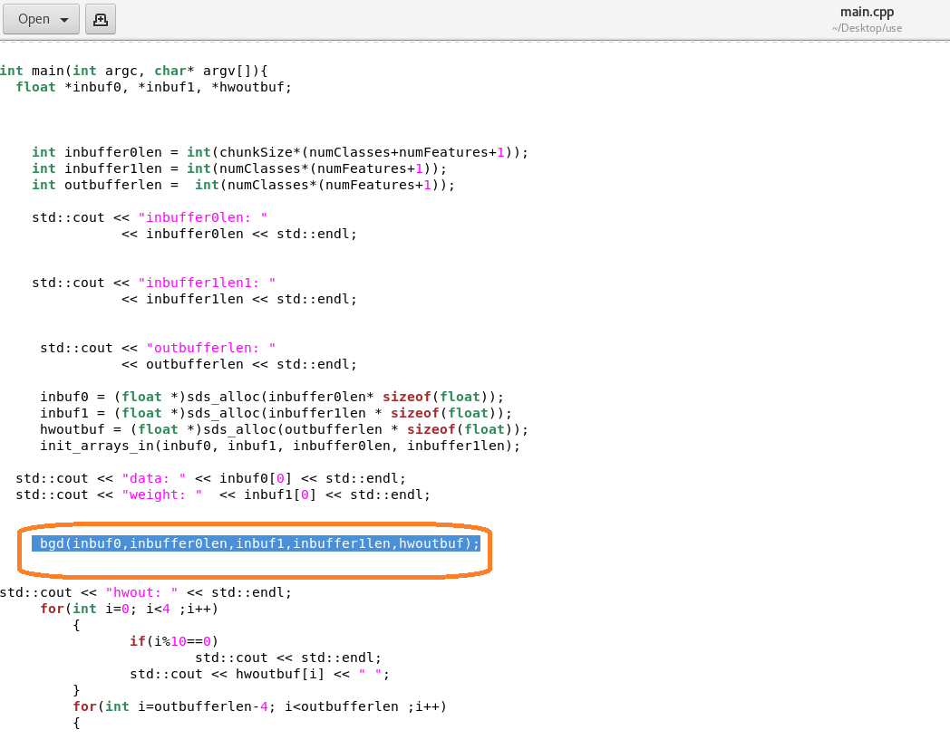

Slide 34
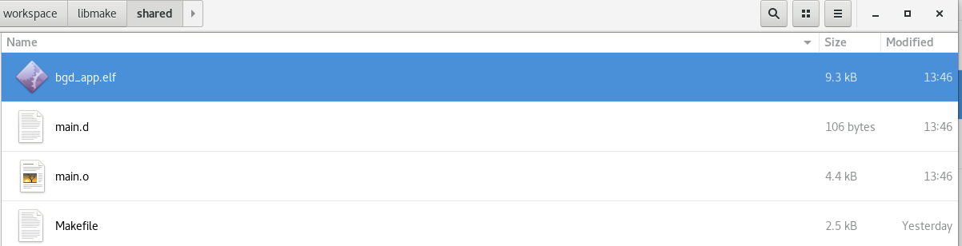
comile

Slide 35
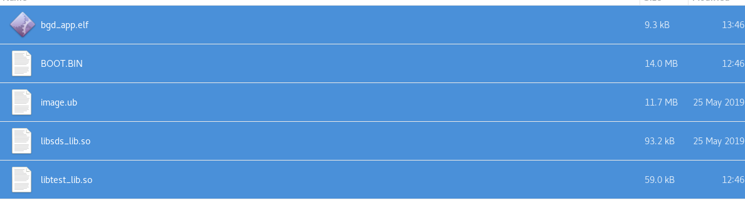
Copy to sd

Slide 36
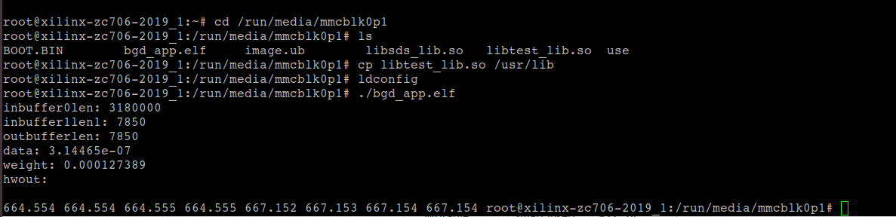
execute

Slide 37
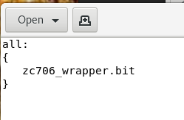
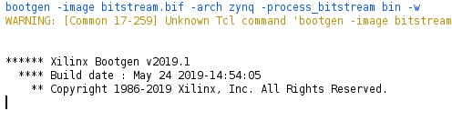
Edit bitstream.bif:
Open vivado, on tcl console,

Slide 38
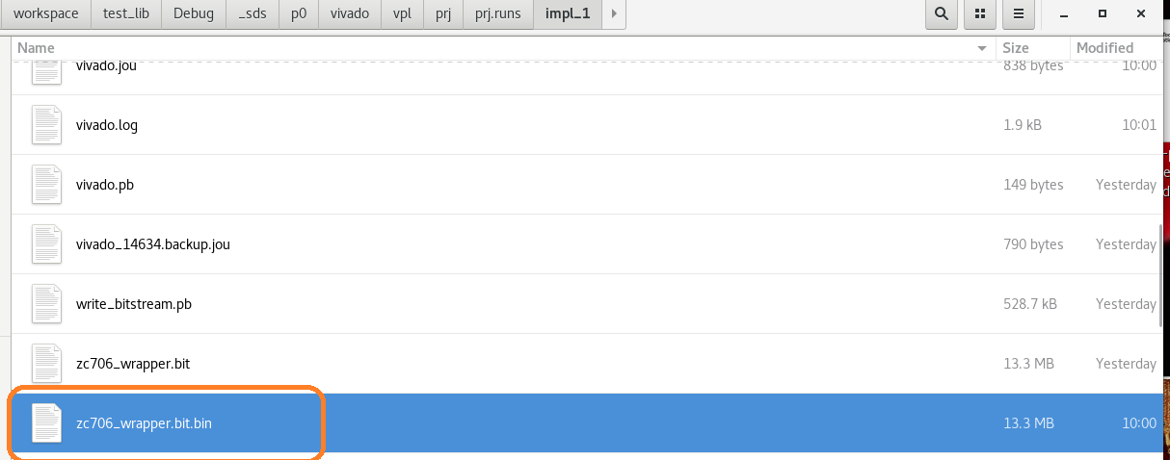

Slide 39
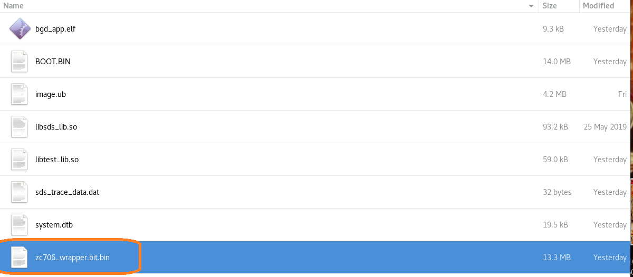
Execute on custom platform

Slide 41


Slide 42


Slide 43


Slide 44
Strace
openat(AT_FDCWD, "/lib/libpthread.so.0", O_RDONLY|O_LARGEFILE|O_CLOEXEC) = 3
openat(AT_FDCWD, "/usr/lib/libsds_lib.so", O_RDONLY|O_LARGEFILE|O_CLOEXEC) = 3
openat(AT_FDCWD, "/usr/lib/libstdc++.so.6", O_RDONLY|O_LARGEFILE|O_CLOEXEC) = 3
openat(AT_FDCWD, "/lib/libm.so.6", O_RDONLY|O_LARGEFILE|O_CLOEXEC) = 3
openat(AT_FDCWD, "/lib/libgcc_s.so.1", O_RDONLY|O_LARGEFILE|O_CLOEXEC) = 3
openat(AT_FDCWD, "/lib/libc.so.6", O_RDONLY|O_LARGEFILE|O_CLOEXEC) = 3
openat(AT_FDCWD, "/dev/mem", O_RDWR|O_SYNC) = 3
openat(AT_FDCWD, "/dev/xlnk", O_RDWR) = 3
openat(AT_FDCWD, "/dev/uio0", O_RDWR|O_SYNC) = 4

